Slide 1

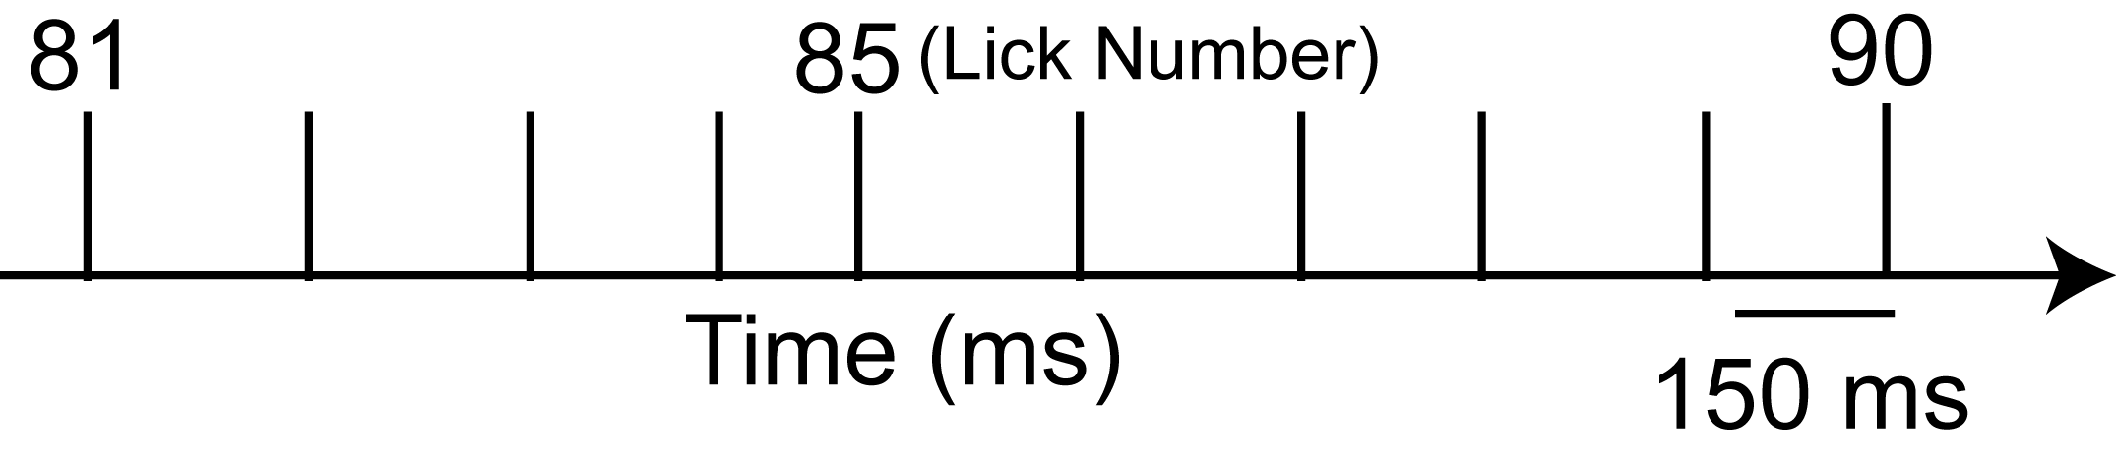
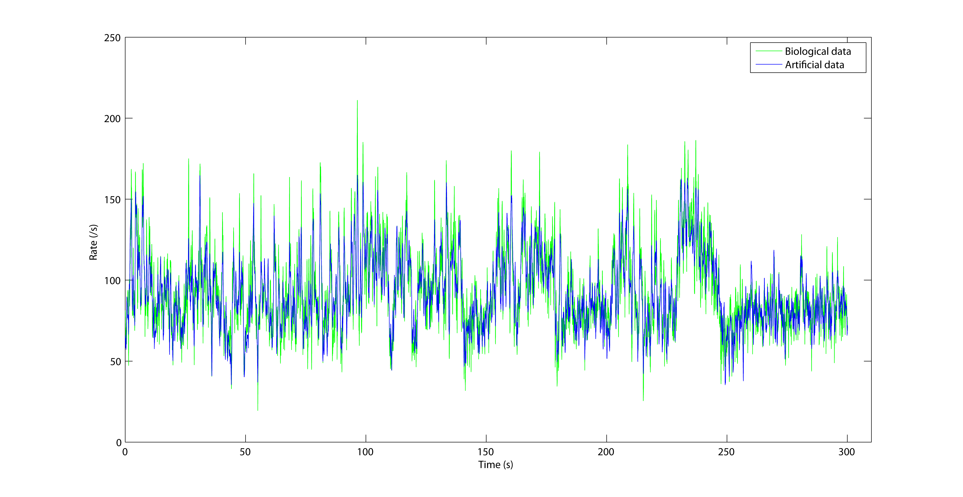
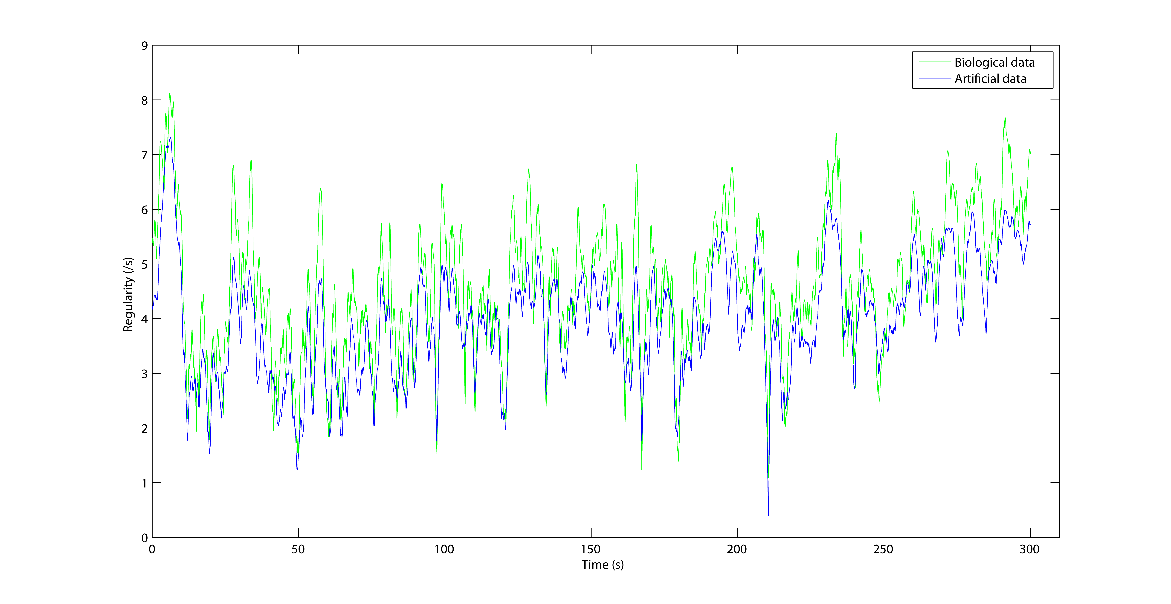
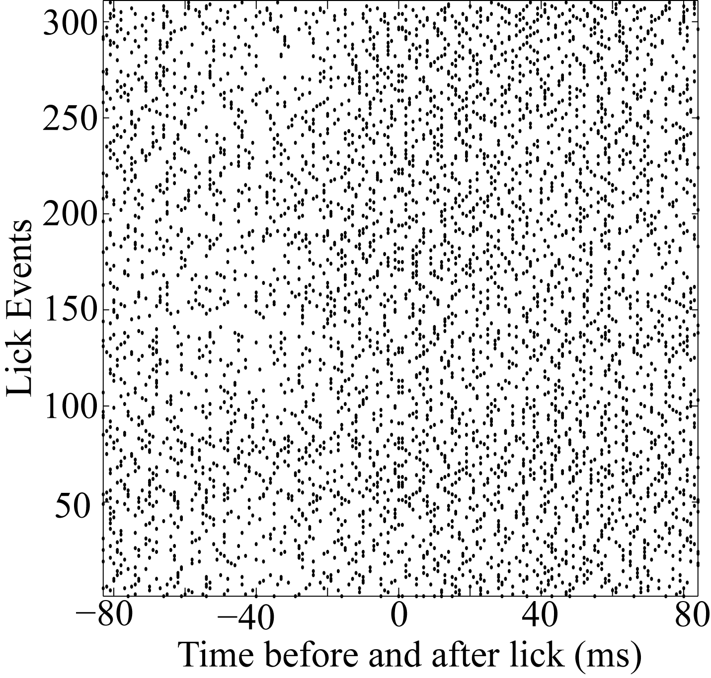
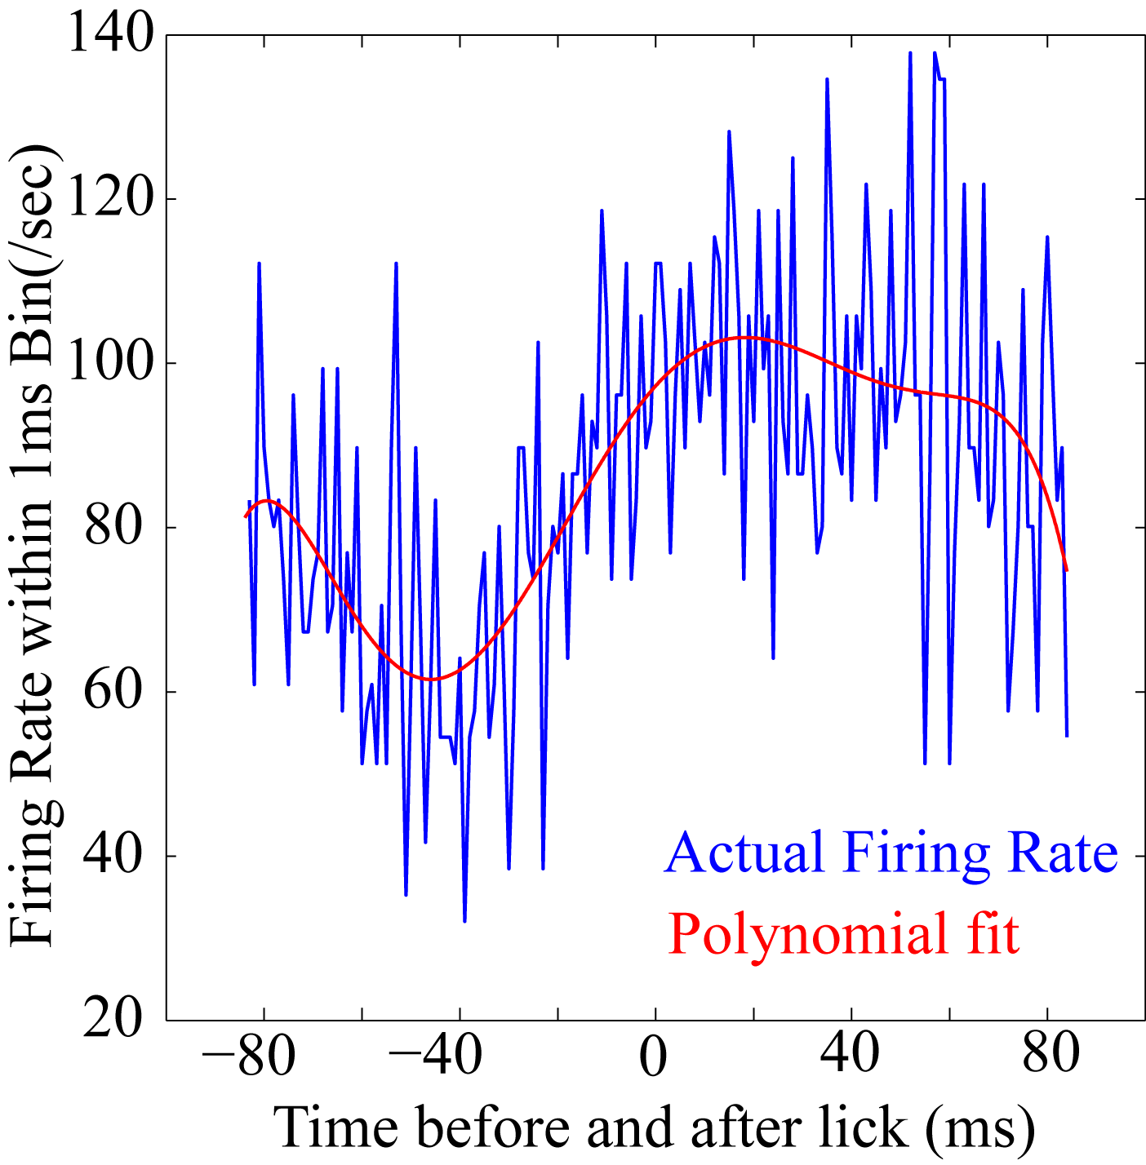
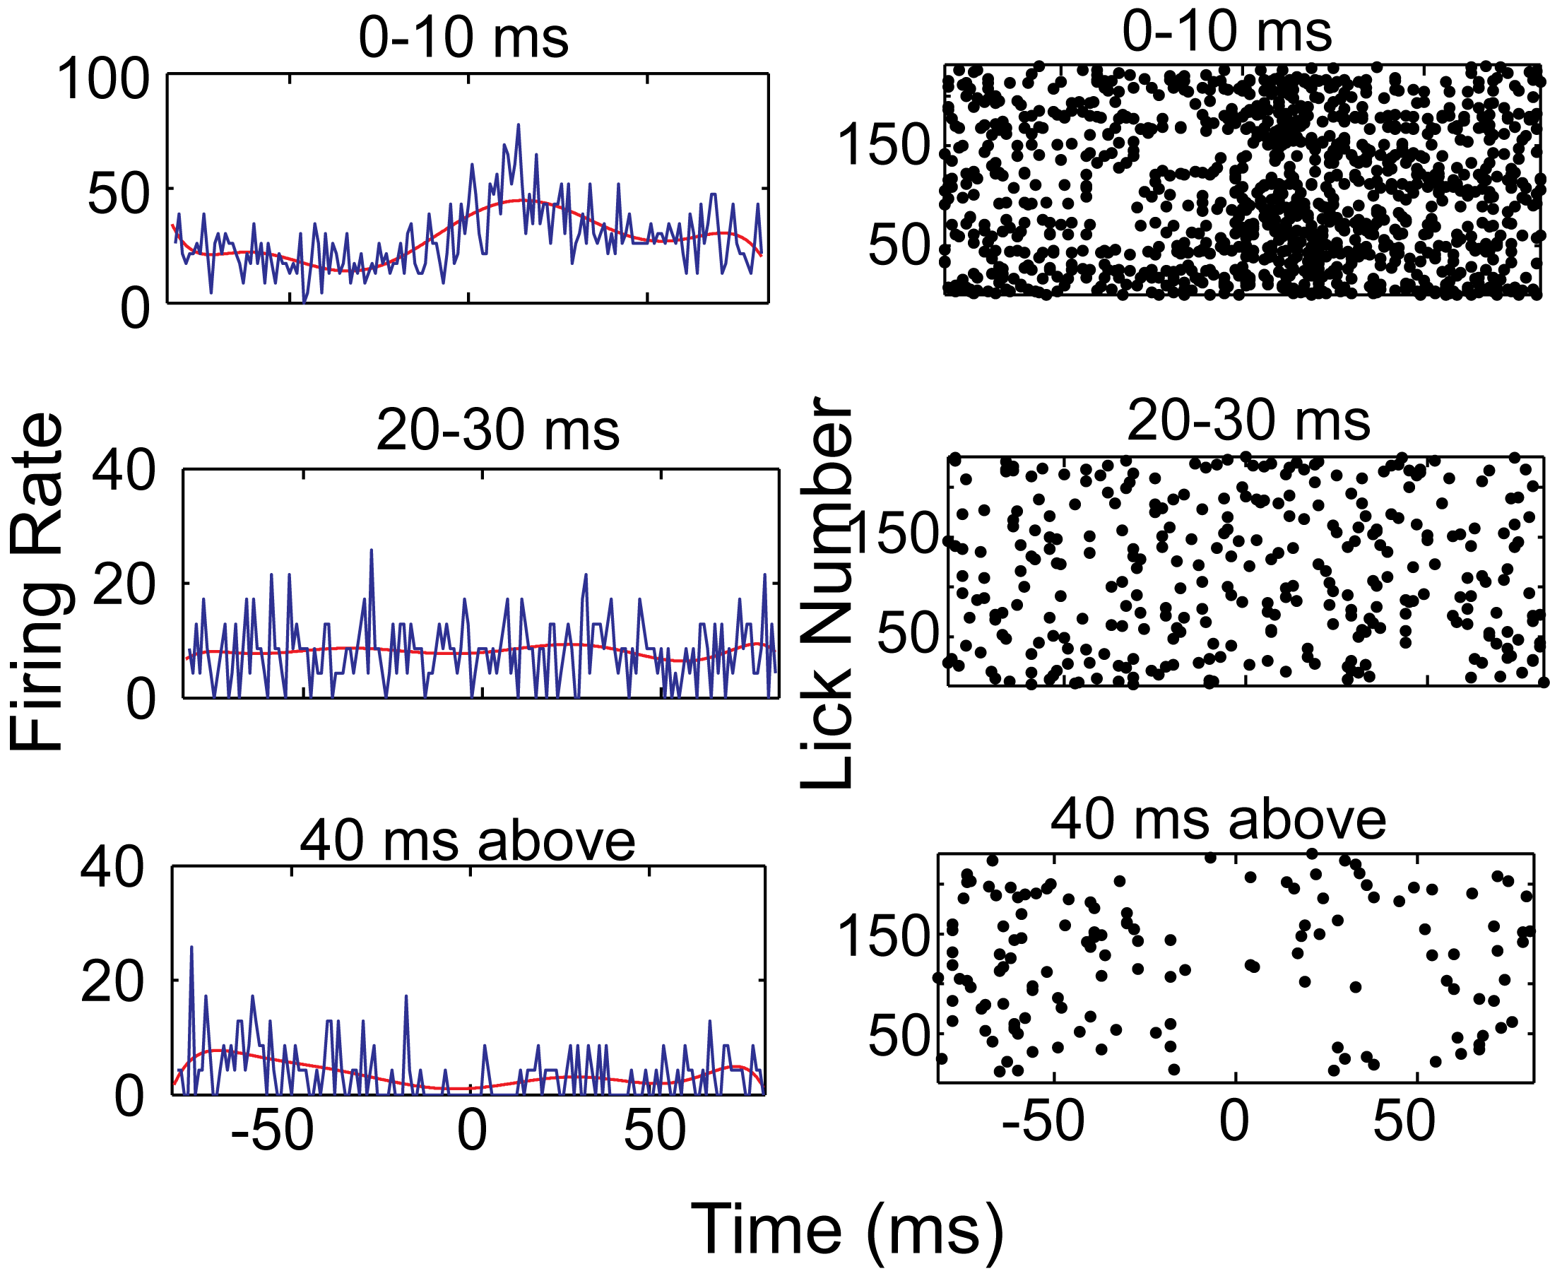
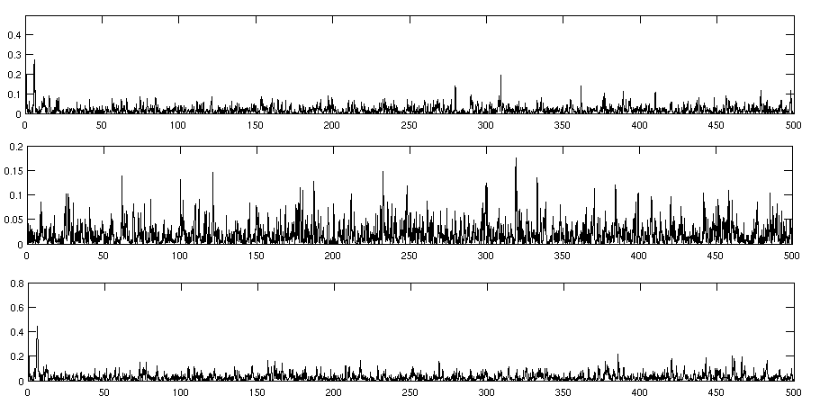
Use of Granger causality analysis and artificial spike trains to examine pause coding in Purkinje cell spike activity related to rhythmic licking
CNS 2011
Poster #445
Selva K. Maran¹ , Ying Cao²,Mukesh Dhamala³3,Detlef Heck², Dieter Jaeger¹
¹Department of Biology, Emory University, Atlanta, ²Department of Anatomy and Neurobiology, UTHSC, Memphis
³Department of physics and Astronomy, GSU, Atlanta
Introduction
Cerebellar Purkinje cells (PCs) in mice show strong activity modulation related to rhythmic licking behavior [1]. Here we examine whether this modulation may preferentially be related to long inter-spike intervals (ISIs), i.e. pauses in spike activity. A preferential use of spike pauses for event coding of Purkinje cells has previously been suggested.
Creation of Artificial spike trains
To better understand the ISI duration dependence of lick coding we constructed artificial spike trains from gamma ISI distributions [5] to match individual PC recordings, both with respect to slow spontaneous activity parameters and to lick-triggered spike rate fluctuations. We adopted a technique (Shinomoto and Shimokawa, ...) that uses bayesian techniques to capture the instantaneous rate and regularity of spike train in gamma distributed spike trains. With this technique we were able to closely match the observed properties of Purkinje cell spike trains: 1) High firing rate with mean firing rate around 80 Hz. 2) A firing pattern that is more regular than Poisson and 3) The presence of slow fluctuations in firing rate above and below the mean firing rate (Figure 3).
Rhythmic modulation in Purkinje cell spiking during licking behavior
Some PC recordings were collected in awake mice that consumed water by performing stereotypic, rhythmic lick movements. Most of these PCs showed clear rhythmic modulation that was phase locked to licking. We estimated rhythmic changes in the firing rate using peri-stimulus time histograms (Figure 1).
Figure 1. Lick-related rhythmic modulation in purkinje cell spiking
Figure 3. A) Firing Rate and B) regularity modulation in recording and artificial spike train.
Figure 1: A) Figure showing rhythmic licking behavior by mice. B) Peri-Stimulus Time Histogram (PSTH). Black dots represents the time at which a spike occurred. '0' in X-axis corresponds to time at which the mice touches the water sprout. From the figure we can infer that there is clear modulation in firing pattern before and after lick. C) Firing Rate estimation from PSTH. The blue trace corresponds to firing rate estimation per 1 ms bin. The blue trace is a 6th order polynomial fit for spike rate modulation.
The ISI dependence of lick modulation in biological data is replicated in artificial gamma distributed spike trains
Lick related modulation occurs both at short and long inter spikeintervals
In order to determine whether there is any special relation between pauses (long interspike intervals) and licking behavior we did peri-lick time histograms and granger causality analysis constructed separately by spikes initiating ISIs of different duration (Figure 2). We found that while short and long ISIs showed lick related modulation, ISIs of intermediate duration did not.
In order to determine whether there is any special relation between pauses (long interspike intervals) and licking behavior we plotted peri-lick time histograms and conducted a granger causality analysis (Mukesh ...) separately for ISIs of different duration (Figure 2). We found that while short and long ISIs showed lick related modulation, ISIs of intermediate duration did not.
Conclusions
1) The methods we developed allowed us to match the statistics of recorded PC spike trains during rhythmic licking behavior.
2) From the results we infer that any relation between specific ISI durations and lick modulation is due to the statistical properties of rate modulated spike trains, and can be mimicked by a simple gamma - distributed process.
Acknowledgement: Funded by NINDS 1 R01 NS067201

